Slide 1
DATABASE COMMUNICATION
AND
REPORT GENERATION CHATBOT
ARNAB MANDAL
ARTIFICIAL INTELLIGENCE AND RESEARCH INTERN

Slide 2
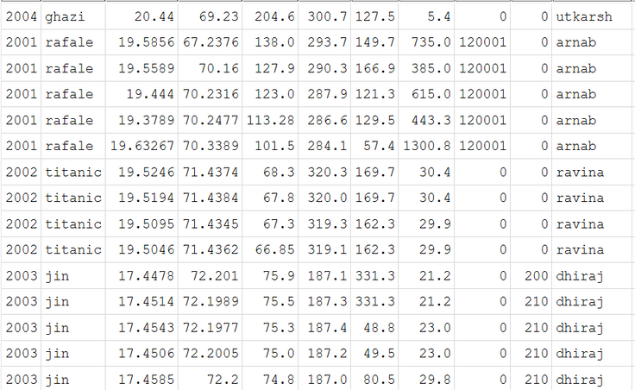
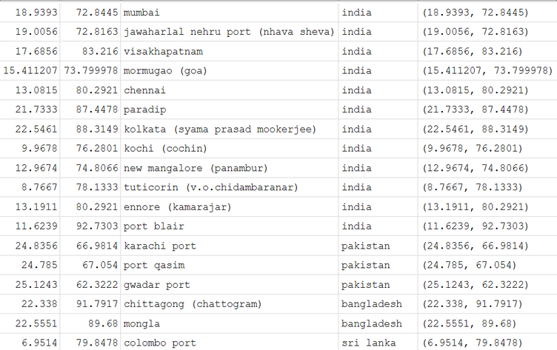
Problem Statement
The objective was to:
Allow the user to communicate with databases in natural language
Automate report generation
Sample data taken from OTAS system
Mock janes data

Slide 3
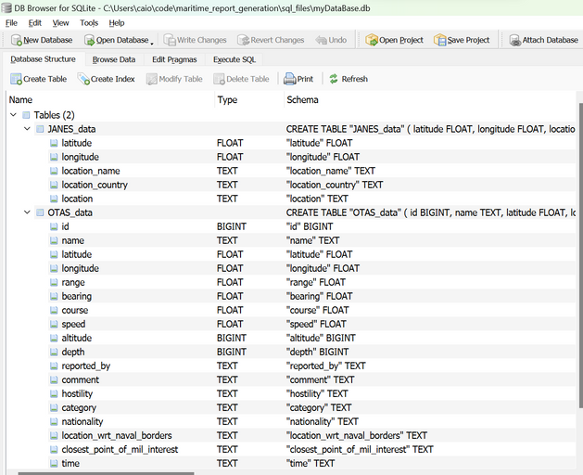
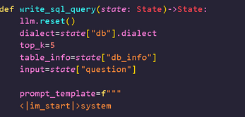
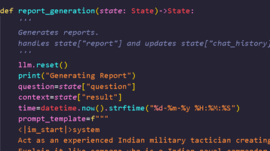
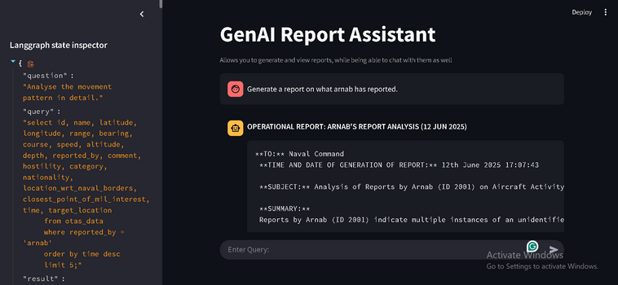
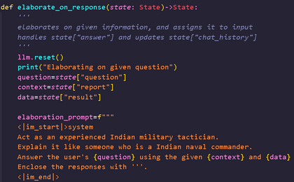
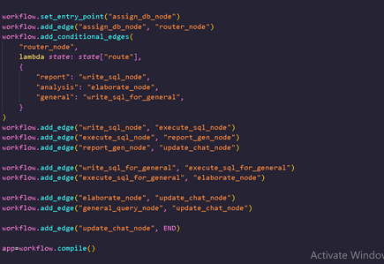
Provided Solution
Prototype frontend
SQL Server
Local LLM for analysis
Utilised streamlit to allow the user to
Chat with the llm
Ask queries in natural language
View generated reports and responses
Download generated PDFS
Created pipeline to handle knowledge transfer from csv datasets to local SQL server
Utilised llama 3.2 to handle all forms of user requests and communicate with sql server.
Handles report generation, analysis and general information requests.

Slide 4
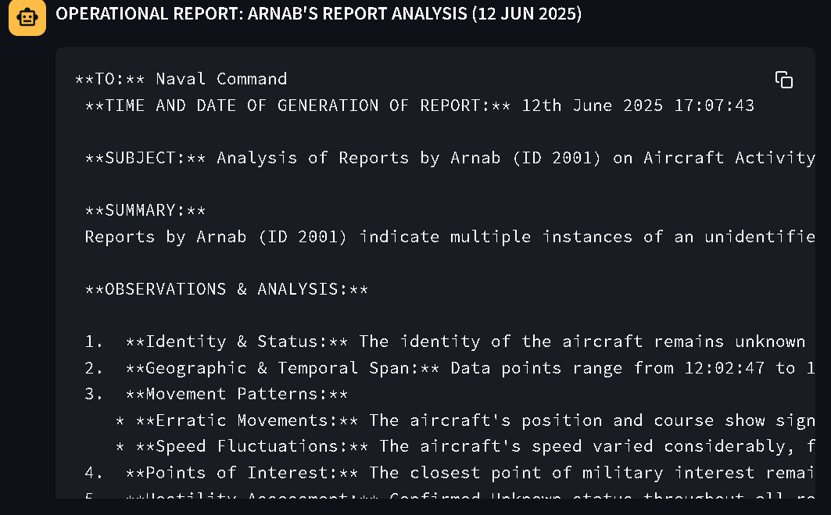
Results and Analysis
Report generation requests, and other supplementary requests at maximum take 7 minutes for detailed responses.
The entire pipeline including the LLM runs completely locally with open-source software, moderated for code quality by non-profit, non-private entities.
Supports addition of future databases with minimal changes that require no technical support.
Effectively handles any hallucination to ensure succinct, relevant responses.

